Slide 1

Move During Your Lunch Break
Notes:
In the last lesson, you learned how to turn your meetings and phone calls into calorie burners.
Another important aspect of your workday is lunch.
Discover how to burn some calories during lunch in today's lesson.
Let’s begin…

Slide 2

How much exercise can you fit into your lunch break?
Notes:
How much exercise can you fit into your lunch break?
From where you get your food to how you spend the break, you can make changes to get more exercise.

Slide 3
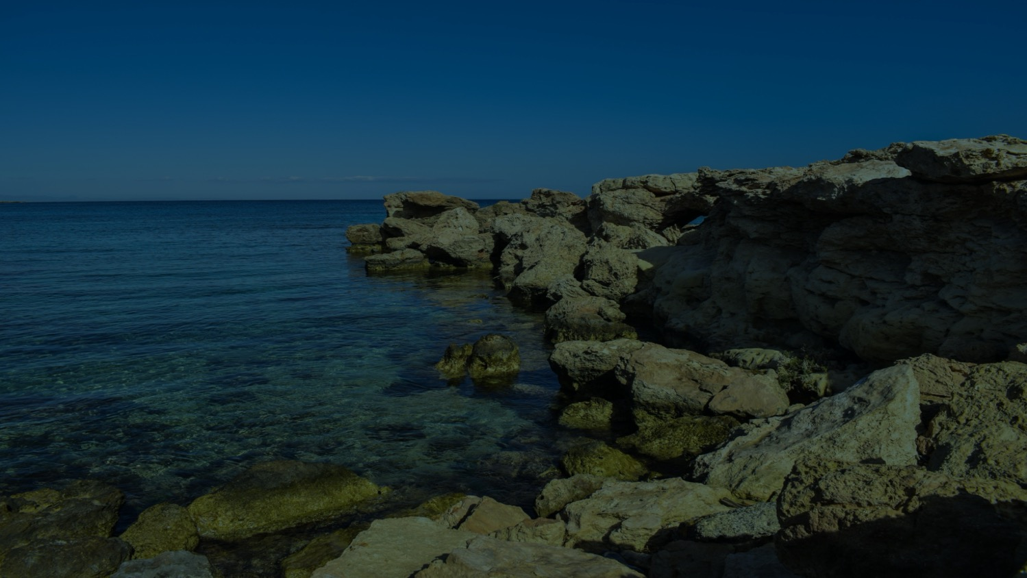
Add to the fun and fitness by encouraging your coworkers to join you.
Notes:
Add to the fun and fitness by encouraging your coworkers to join you.

Slide 4

Try out these positive adjustments to add activity to your lunch break…
Notes:
Try out these positive adjustments to add activity to your lunch break…

Slide 5
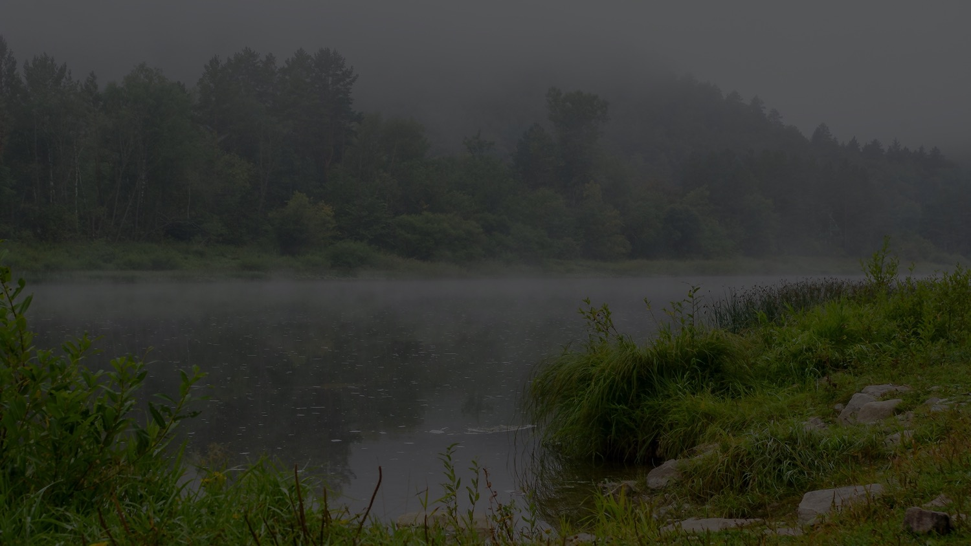
1. Get up from your desk.
Notes:
Get up from your desk.
It's easy to spend the entire day at your desk without moving or standing.
The lunch break is your chance to get up and move.

Slide 6

Your body will appreciate every second of activity.
Notes:
Even if your only option is to eat in another room or walk around and go back to your desk, this is still an excellent opportunity to get moving.
Your body will appreciate every second of activity.

Slide 7
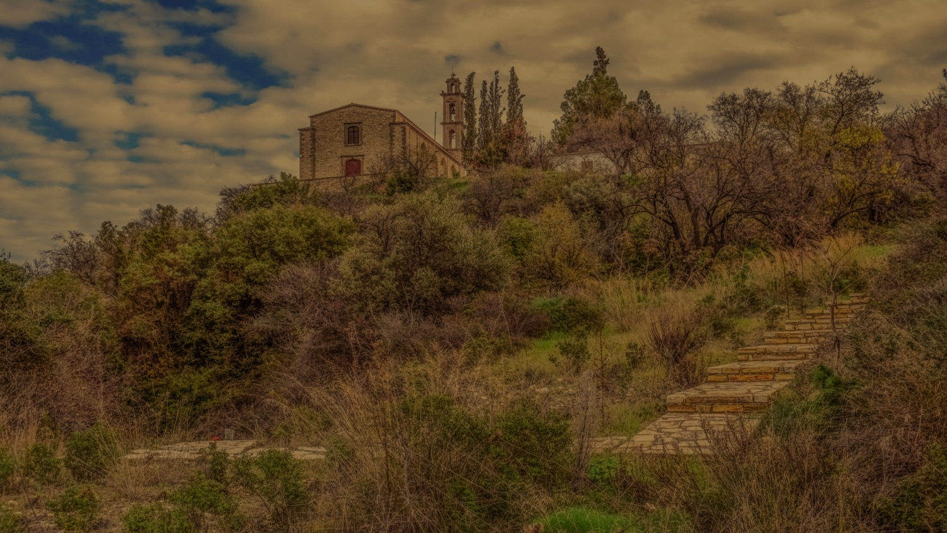
2. Get your food.
Notes:
2. Get your food.
Keep your food in a refrigerator that's far away,
so you'll have to walk to get to your food and you're not tempted to snack mindlessly.
The extra steps to the fridge can add up during the week.

Slide 8
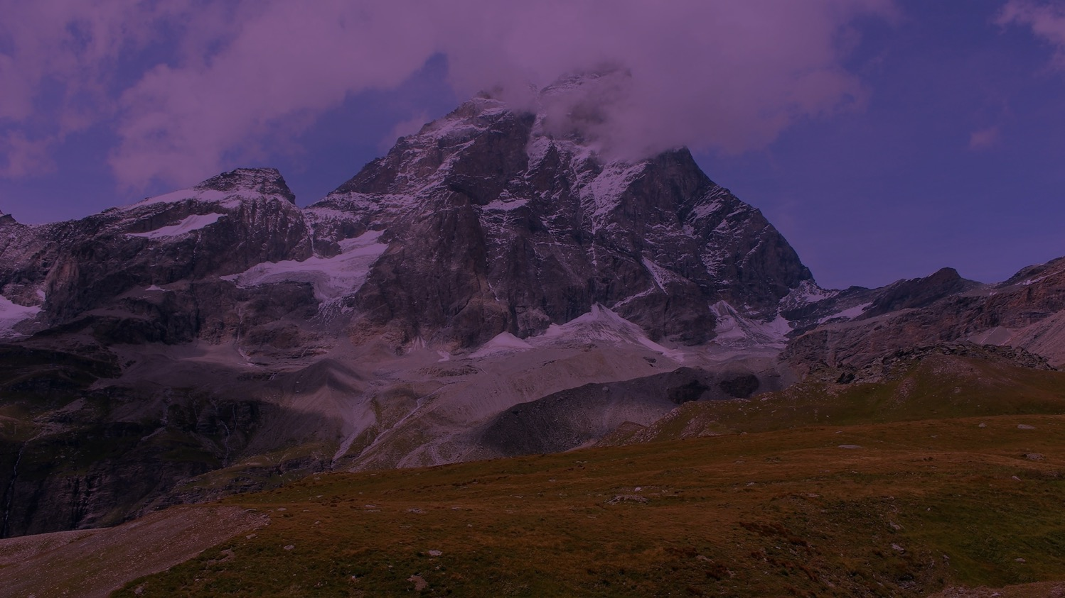
By walking, you'll burn calories and tone your legs.
Notes:
If you prefer to eat out during lunch, consider walking to a restaurant or café that is close to work.
By walking, you'll burn calories and tone your legs.

Slide 9

3. Use the break to run errands.
Notes:
3.Use the break to run errands.
The lunch break is often the only chance you get to run errands.
Consider how you can use the time to get more activities done.

Slide 10
This is the time to
catch up on tasks.
Notes:
This is the time to catch up on tasks you can't do earlier or later in the day.

Slide 11
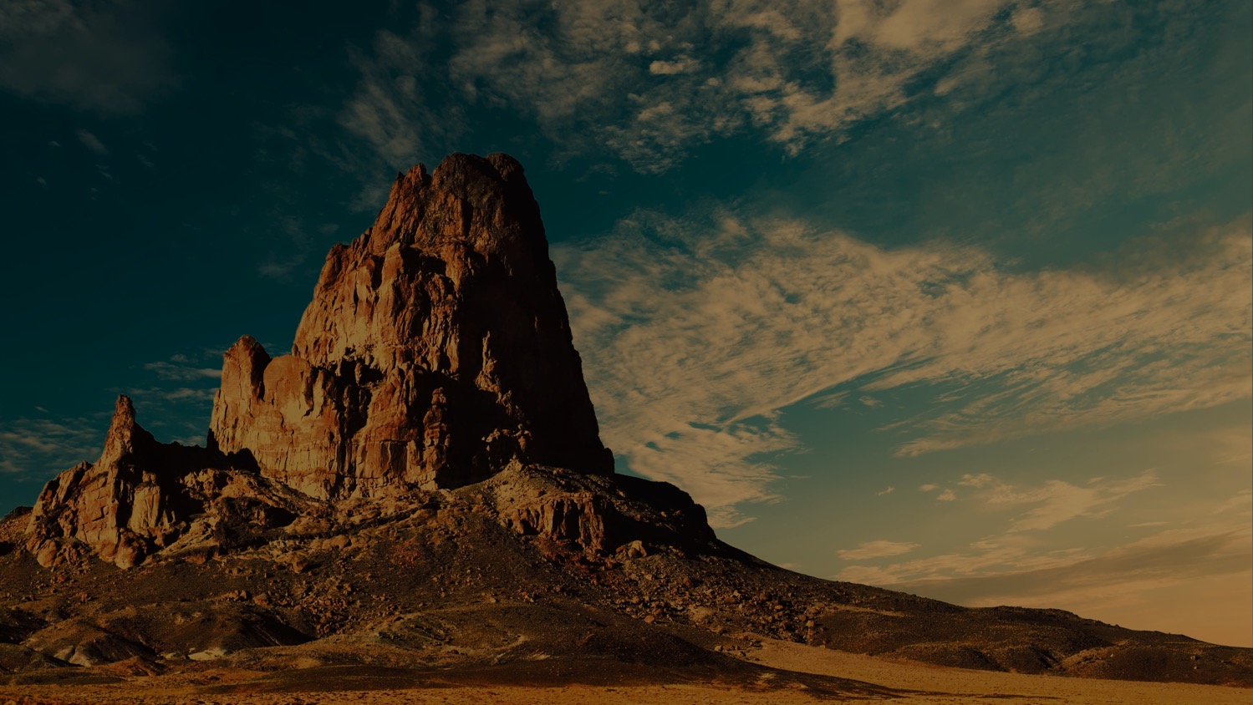
Try to patronize shops close to your office so you can walk while running errands.
Notes:
You may want to mail packages, pick up dry cleaning, or go shopping.
Try to patronize shops close to your office so you can walk while running errands.

Slide 12
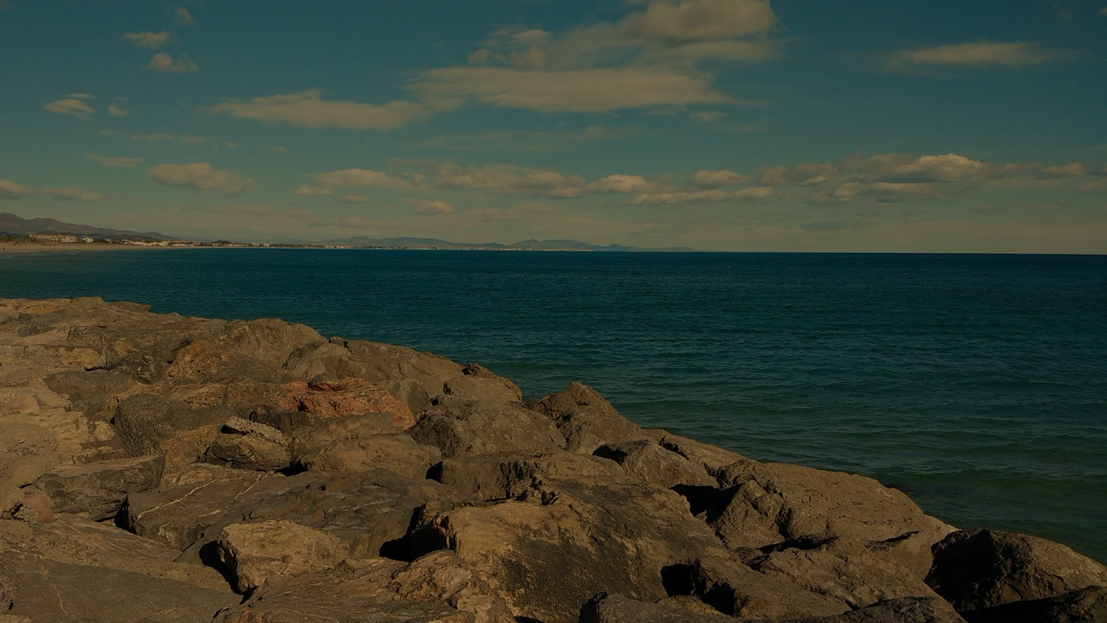
4. Go outside.
Notes:
4. Go outside.
If you're able to eat outside, use this opportunity to get fresh air and exercise.

Slide 13

During long lunch hours, walk or bike to a park.
Notes:
During long lunch hours, consider walking or biking to a park to eat.

Slide 14
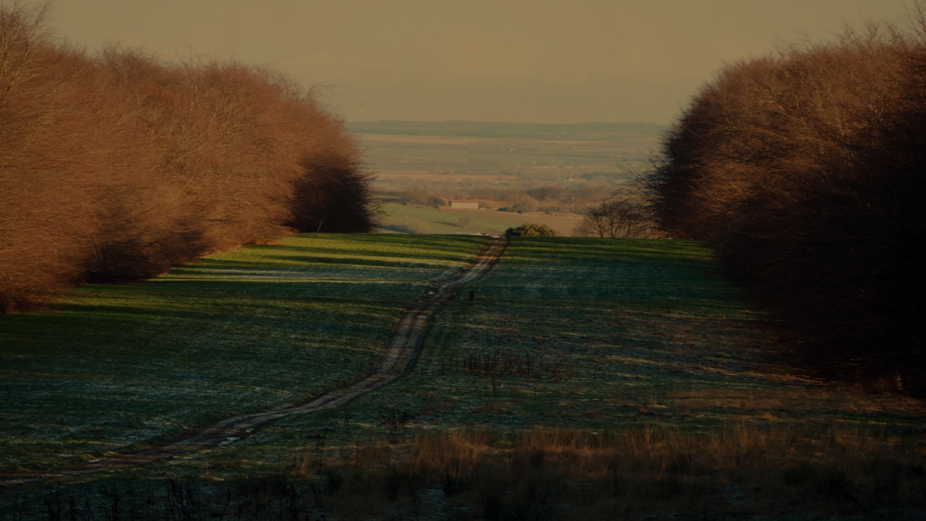
During short lunch hours,
go outside your building.
Notes:
During short lunch hours, consider going outside to a courtyard near your office or simply outside your building.

Slide 15
Find a quiet balcony, sidewalk, or other nook
that gives you room to pace.
Notes:
Even if you don't have a dedicated green space near your job, you can still enjoy the fresh air.
You may be able to find a quiet balcony, sidewalk, or other nook that gives you room to pace.

Slide 16
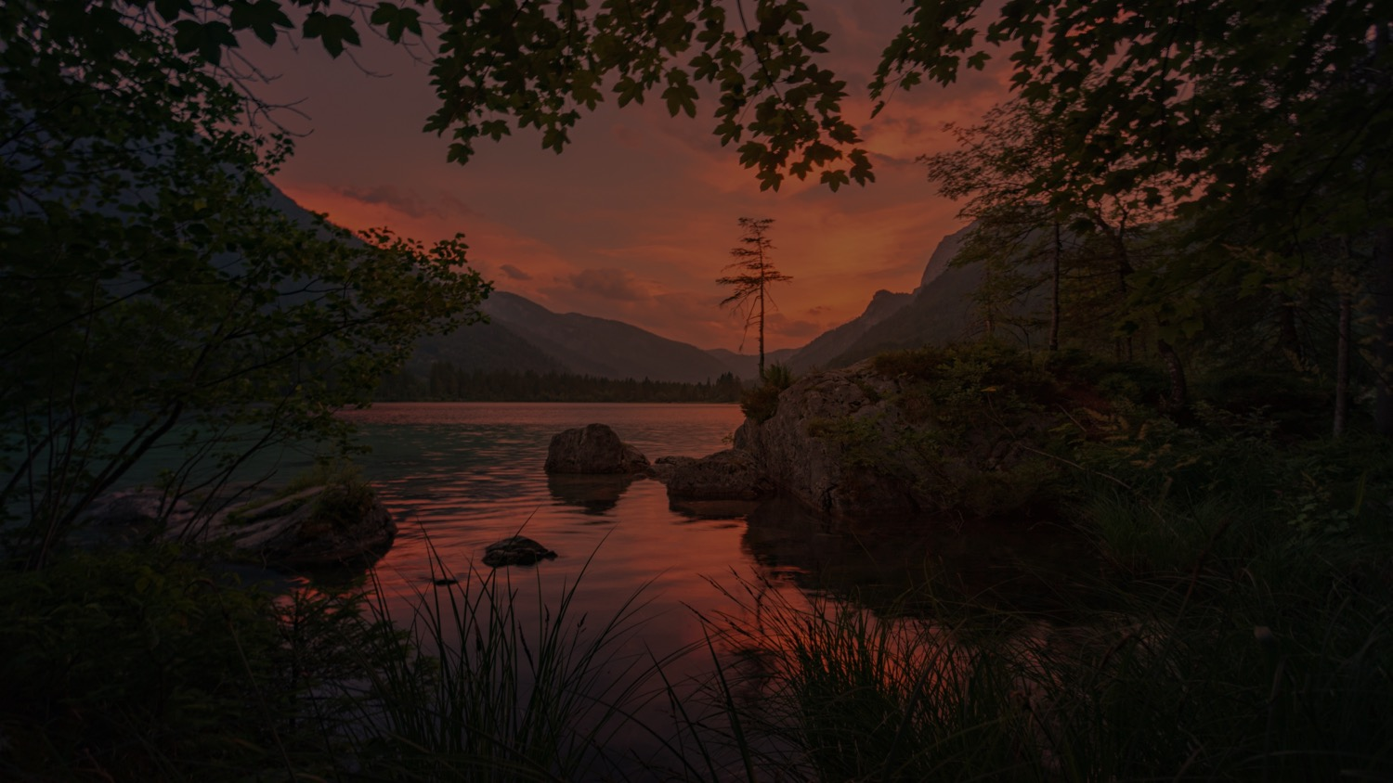
5. Get a workout.
Notes:
5. Get a workout.
If you can squeeze in a workout during lunch hour, this is ideal.

Slide 17
You can do short workouts
in your office or outside.
Notes:
You can do short workouts in your office or outside in the fresh air.
Organize your coworkers to form a small team of dedicated exercise partners.

Slide 18
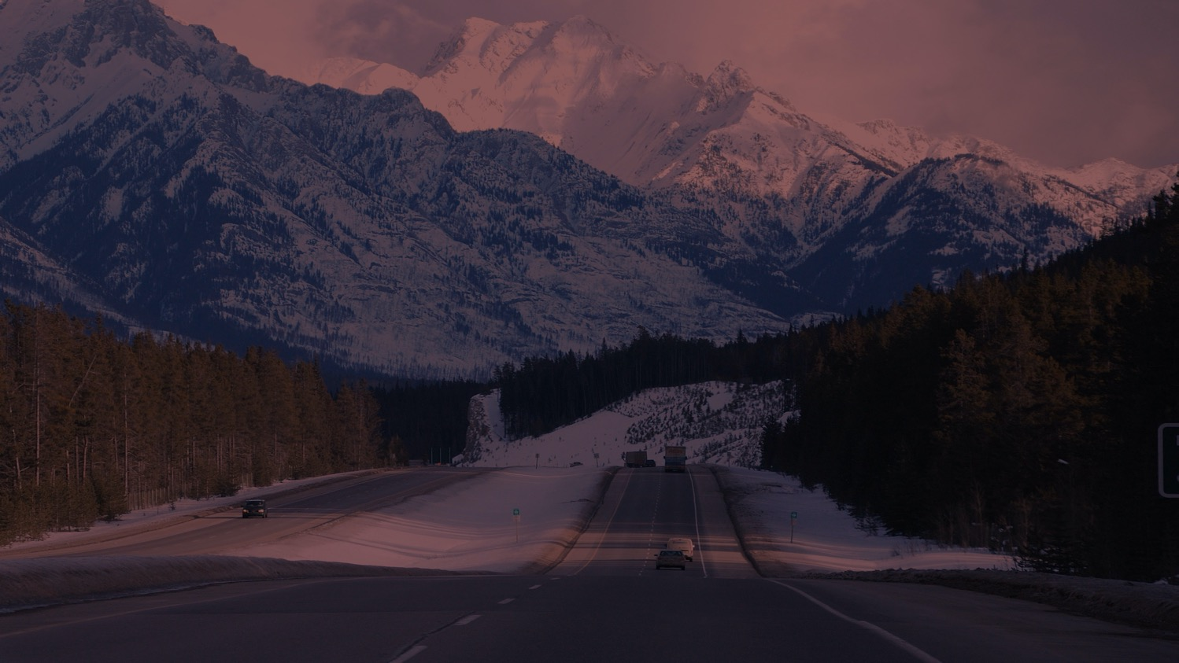
Use the time to practice yoga, do aerobics, or play a friendly game of sports.
Notes:
Use the time to practice yoga, do aerobics, or even play a friendly game of sports.

Slide 19
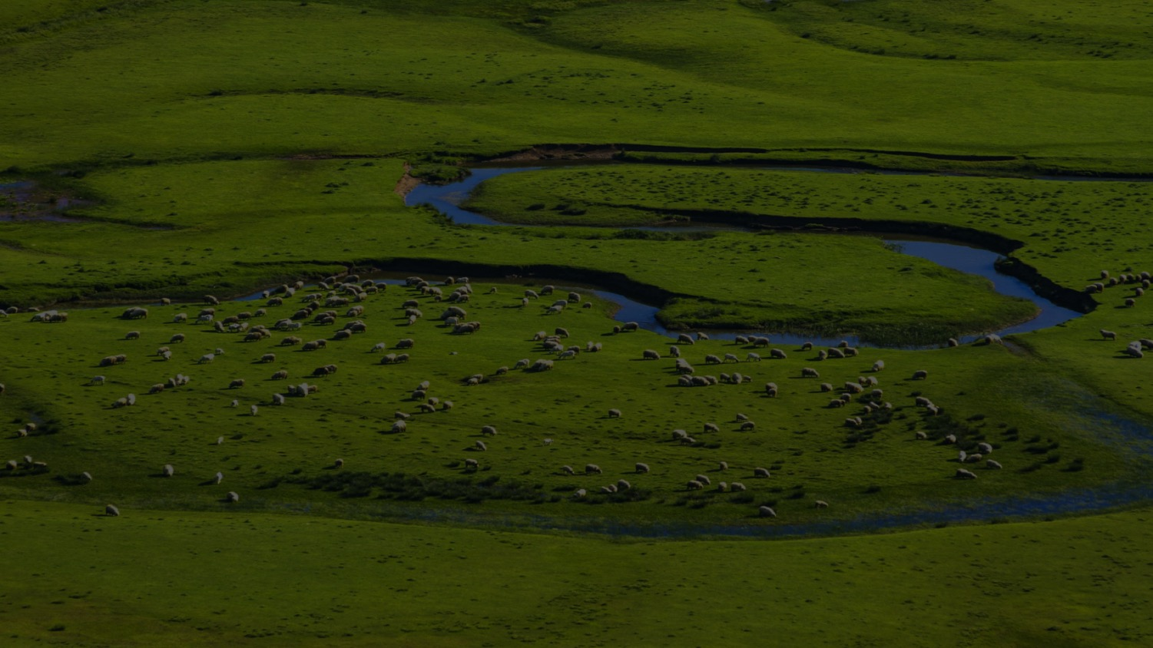
Exercise can become a normal part of your lunch break at work.
Notes:
Exercise can become a normal part of your lunch break at work.
You may even look forward to it as a highlight of your day.

Slide 20
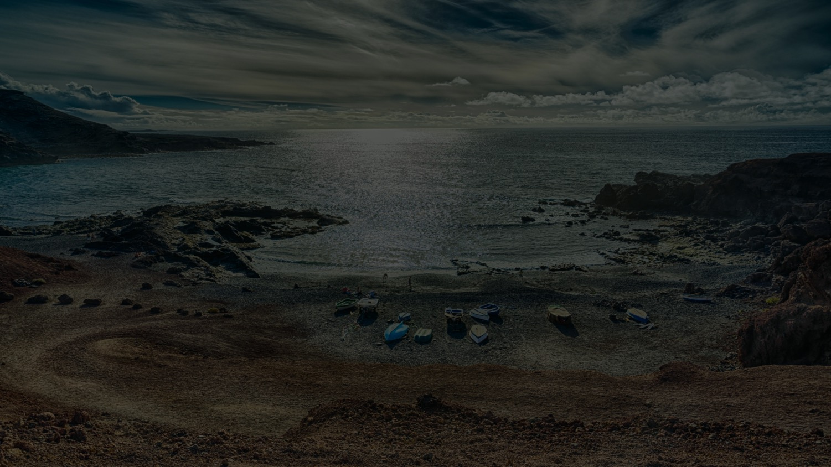
Kudos to you!
You've reached the
end of Module 2!
Notes:
Kudos to you!
You've reached the end of Module 2!

Slide 21
You'll find some awesome tips in Module 3 to make exercise more appealing.
Notes:
Looking forward, you'll find some awesome tips in Module 3 to make exercise more appealing.
You'll see how you can make it fun, easier, and more effective for you.

Slide 22

We’ll pause for
summary and reflection.
Notes:
Before we go on to Module 3, though, we'll pause for summary and reflection of Module 2.
But first…

Slide 23
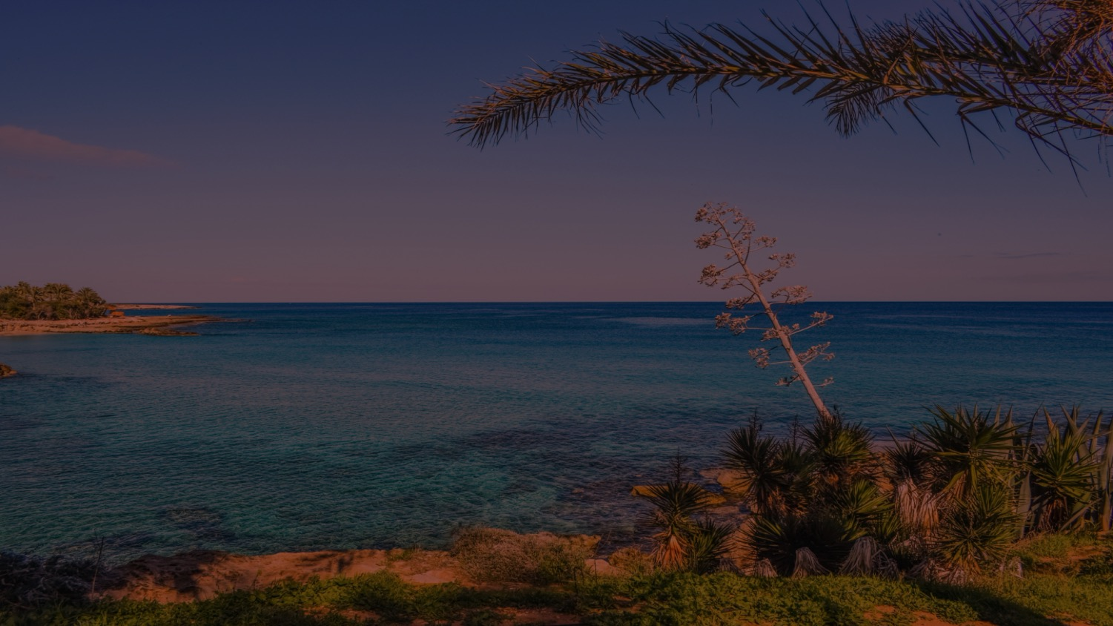
Here's what you need to do today…
Notes:
Here's what you need to do today…

Slide 24
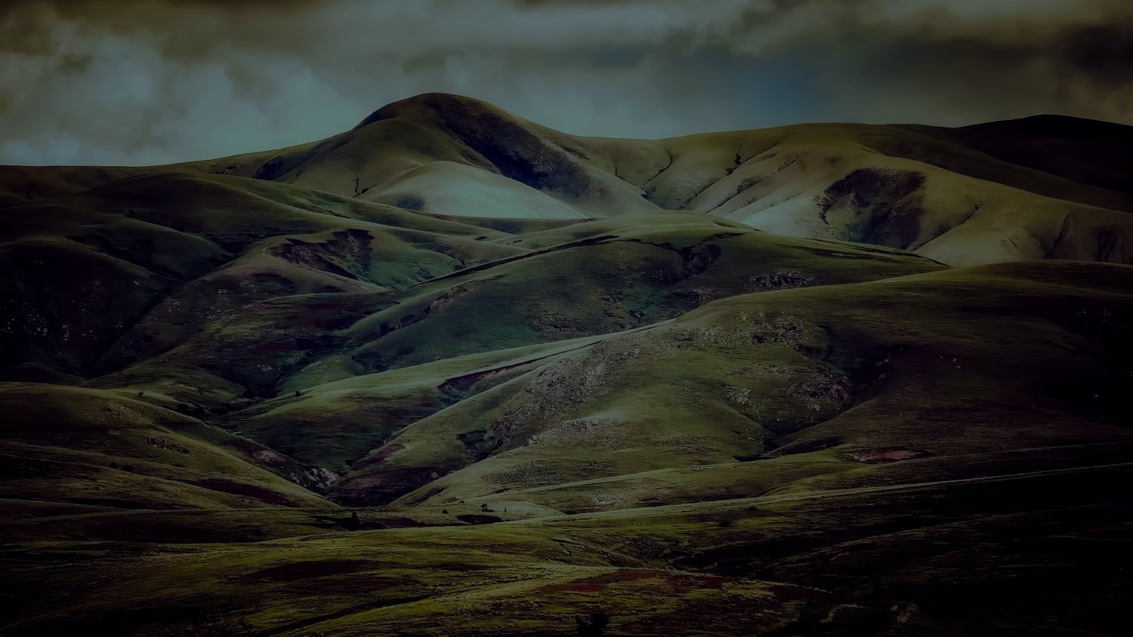
1. Brainstorm how you can add additional movement to your lunch break.
Notes:
Brainstorm how you can add additional movement to your lunch break.
Make a list of your ideas.
Take action on your ideas to burn more calories.

Slide 25
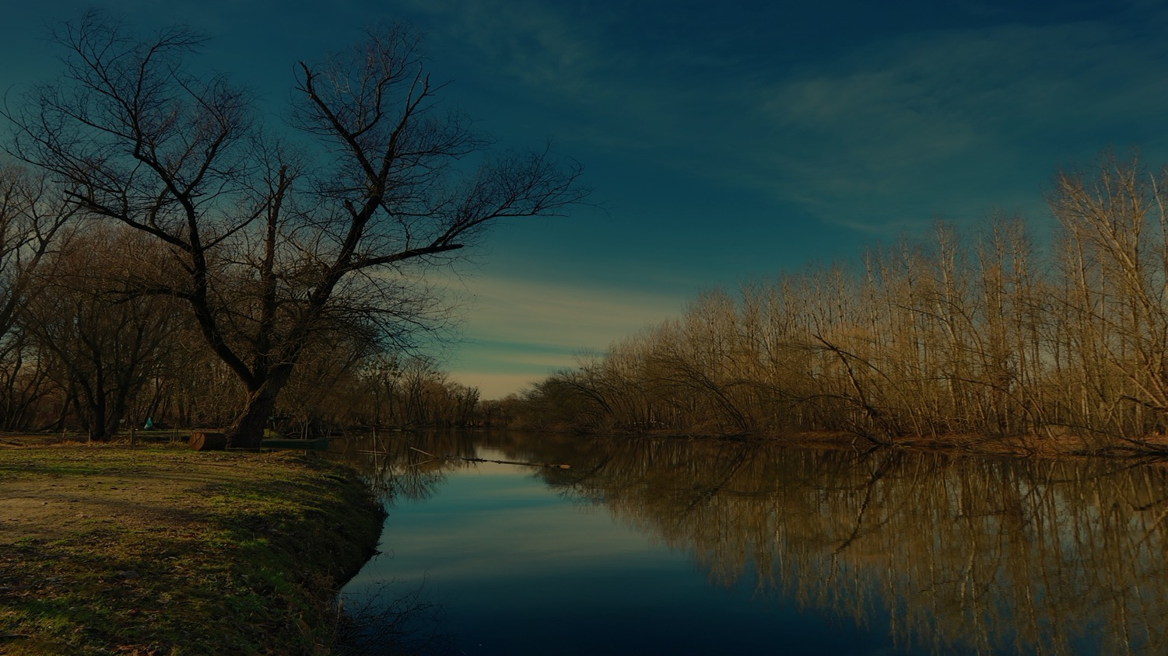
2. Invite your coworkers to join you in your new lunch activities.
Notes:
2. Invite your coworkers to join you in your new lunch activities.
Have fun, and we’ll see you in Module 3!

